Slide 1
Professional Practice of Education Assistants
Working with Colleagues - Educator on Call Book

Slide 2

Working with Colleagues
Educator on Call (EOC or sub book)
Describes:
  Student
  Supports in classes & activities
  School
  Breaks
  What you need to know to do your job that day
  Policies

Slide 3
Student Information
Describes the student and how to support the student’s learning, participation, belonging
Critical health and safety information
What are some points already discussed in this course, and others, that you can use to inform HOW you will write this information?

Slide 4
Personal Profiles
John
Frightened of crowds
Non verbal
Can’t read
IQ of 42
Withdrawn
Clumsy & overweight
Rob
Helpful
Social butterfly; jokester
Little shy
Responsible; co-operative
Emergent reading skills

Slide 5
Personal Profiles
John
Compulsive about checking his watch
Developmentally disabled and brain injured
Future: group home, day program, go to mall and watch TV
Rob
Loves football; assistant manager of the football team
Has a job in a store
Future: work in family business, join fitness club, live in apartment with roommates, hang out with friends

Slide 6
What makes these individuals so different?
What explains why their futures are so different?
6

Slide 7
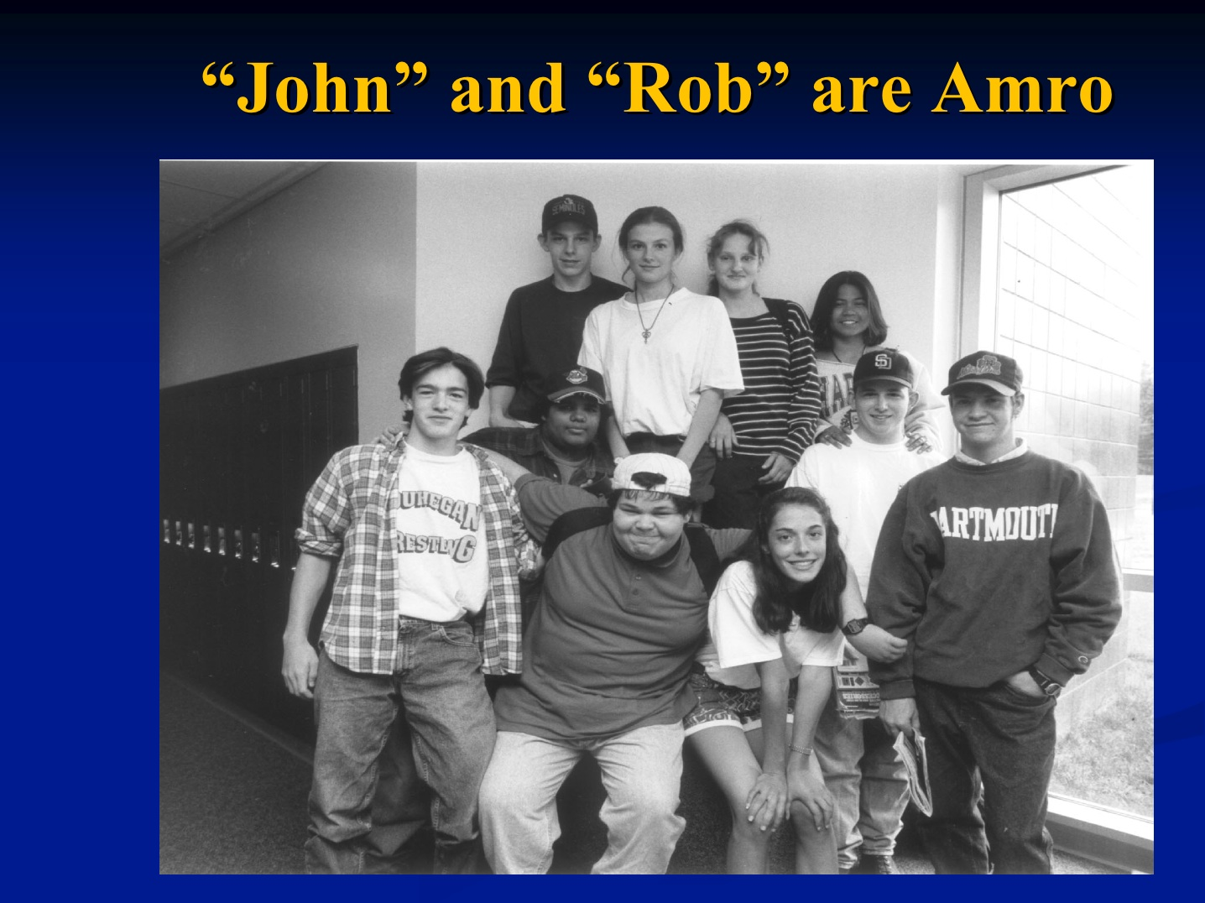
John & Rob are the same person!
Amro (student in New Hampshire, 2008)
(from Cheryl Jorgensen presentation July 2008 @NDSC)

Slide 8
Activity: Educator on Call Books
Work in pairs.
Review the EOC outlines for elementary and secondary schools.
Discuss:
  What are you noticing about each of the booklets?
  How are they the same / different?
  What have you learned from other courses that relates to what an Education Assistant would write in these types of booklets?

Slide 9
Activity: Educator on Call Books
Work in pairs.
Review completed EOC booklets.
Discuss:
  What are you:
    Noticing?
    Wondering about?
    Think is well done? Think could be done differently?

Slide 10
Effective & Appropriate Writing in EOC booklets
People First, strength based
Jargon free
Descriptive language (not judgmental or evaluative)
Objective
Succinct and clear
Correct spelling, grammar, etc.

Slide 11

Activity: Summary of the Day
Complete sheet.
Exchange sheet with a peer.
Review by checking those you agree with and discussing those you disagree about.

